Slide 1


MASS TRANSFER
CHE 213
INNOVATION PROJECT
https://www.canva.com/design/DAGk-7cU2fM/F0G1bbz4LfJil2AYgsso1A/edit?utm_content=DAGk-7cU2fM&utm_campaign=designshare&utm_medium=link2&utm_source=sharebutton
Group - 28

Slide 2
TEAM MEMBERS
Armaan P. Pasayat (230195)
Shivam V. Dongare (230971)
Venugopal Nayak (231140)

Slide 3
INNOVATION
In this project, carbon dioxide gas was generated by reacting acetic acid with baking soda inside a sealed container. The produced CO₂ was transferred through a pipe into a bowl of water, where it bubbled and dissolved. As the gas dissolved, it formed carbonic acid, leading to a gradual decrease in the pH of the water. This experiment demonstrated the principles of gas-liquid mass transfer and the chemical impact of dissolved gases on liquids.

Slide 4
PRINCIPLE
Gas-liquid mass transfer occurs when a gas moves across the gas-liquid interface into the liquid due to a concentration gradient.
In this experiment, CO₂ gas generated from the chemical reaction diffused into the water, where it dissolved and subsequently reacted to form carbonic acid.
The formation of carbonic acid and its dissociation into hydrogen ions caused a decrease in water pH, demonstrating chemical absorption alongside physical mass transfer.
This highlights how mass transfer and chemical reaction can occur simultaneously, altering the properties of the absorbing medium.

Slide 5
APPARATUS :
CHEMICALS :
Sealed Reaction container
Baking Soda(NaHCO3)
Pipe/Tube
Acetic Acid(CH3COOH)
Bowl
Water(H2O)
pH meter

Slide 6
PROCEDURE
Prepare a tightly sealed container.
Add acetic acid and baking soda into it.
Insert a pipe into the container.
Allow CO₂ gas formed to bubble into water bowl.
Record pH of water over time using pH meter.
Observe change in pH.

Slide 7
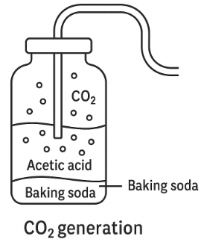
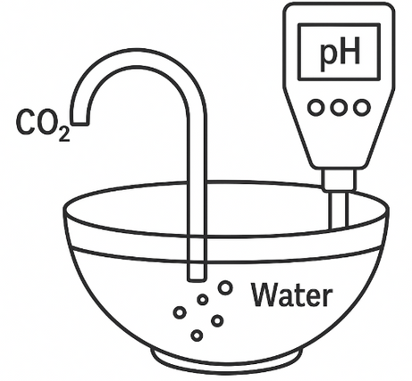

LINE DIAGRAM

Slide 8
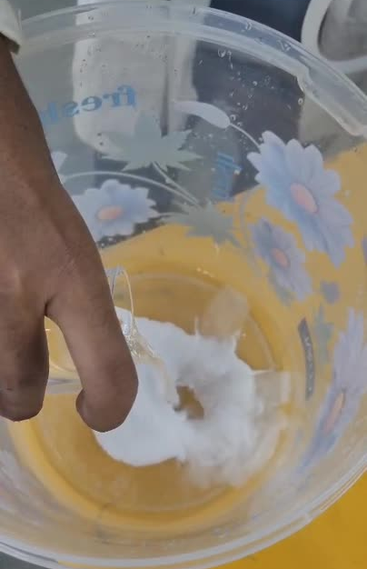
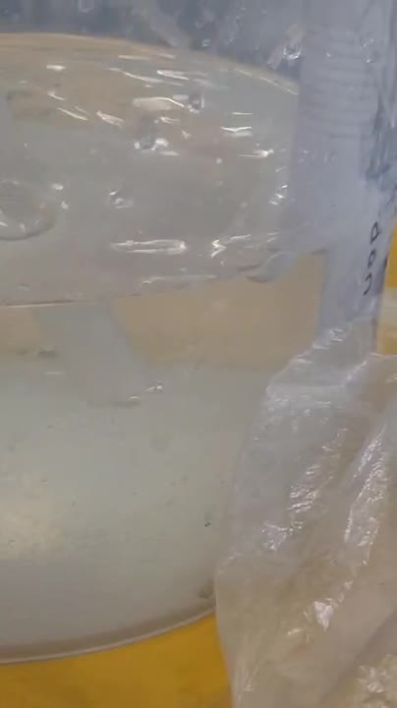
LAB SETUP VIDEO

Slide 9
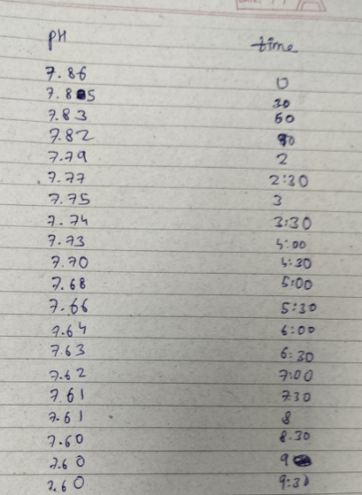
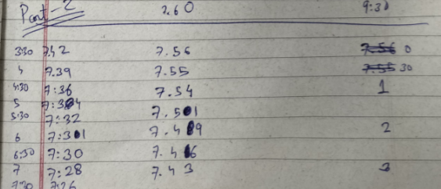
OBSERVATIONS

Slide 10
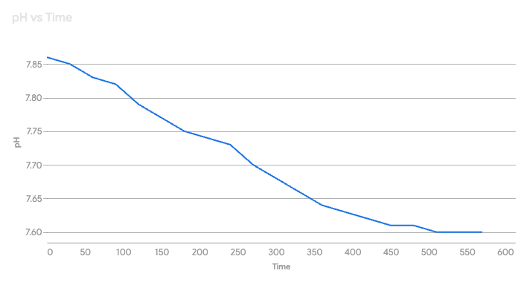
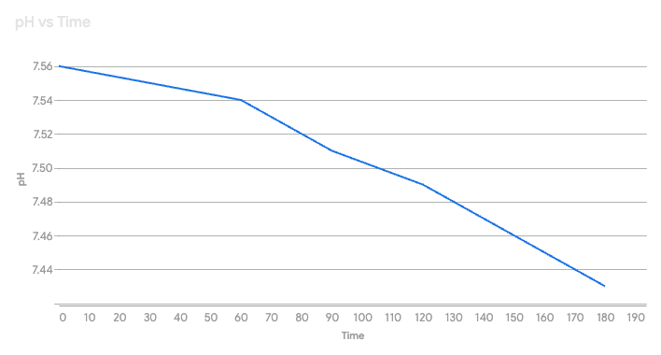
OBTAINED CURVES
TAKE 1
TAKE 2

Slide 11
CONCLUSION
In this experiment, CO₂ gas generated from the reaction of acetic acid and baking soda was successfully transferred into water, leading to a noticeable drop in pH.
The dissolved CO₂ formed carbonic acid (H₂CO₃), which partially dissociated into hydrogen ions (H⁺) and bicarbonate ions (HCO₃⁻), increasing the acidity of the water.
This process demonstrated key principles of gas-liquid mass transfer coupled with chemical absorption.
The experiment highlights how the dissolution of a gas can significantly alter the chemical properties of a liquid — a principle relevant to applications like carbon capture and industrial gas scrubbing.

